Slide 1
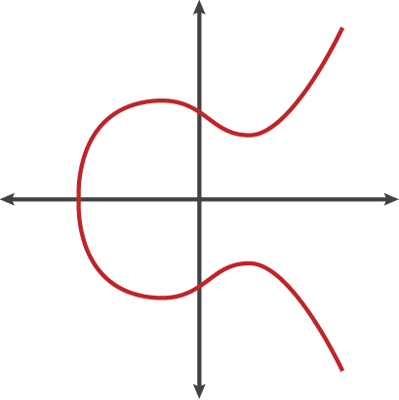
Elliptic curve cryptography Abdullah Mosleh – Abdulrahman AlMayman -

Slide 2
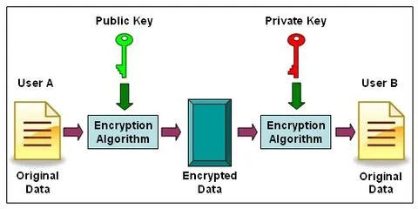
What is Elliptic Curve Cryptography?
Elliptic Curve Cryptography (ECC) is a key-based technique for encrypting data. ECC focuses on pairs of public and private keys for decryption and encryption
ECC, an alternative technique to RSA, is a powerful cryptography approach. It generates security between key pairs for public key encryption by using the mathematics of elliptic curves.

Slide 3
ECC vs RSA
ECC | RSA
The difference in size to security yield between RSA and ECC encryption keys is notable. The table below shows the sizes of keys needed to provide the same level of security.

Slide 4
ECC vs RSA
ECC | RSA
160bit
The difference in size to security yield between RSA and ECC encryption keys is notable. The table below shows the sizes of keys needed to provide the same level of security.

Slide 5
ECC vs RSA
ECC | RSA
160bit | 1024bit
The difference in size to security yield between RSA and ECC encryption keys is notable. The table below shows the sizes of keys needed to provide the same level of security.

Slide 6
ECC vs RSA
ECC | RSA
160bit | 1024bit
256bit
The difference in size to security yield between RSA and ECC encryption keys is notable. The table below shows the sizes of keys needed to provide the same level of security.

Slide 7
ECC vs RSA
ECC | RSA
160bit | 1024bit
256bit | 3072bit
The difference in size to security yield between RSA and ECC encryption keys is notable. The table below shows the sizes of keys needed to provide the same level of security.

Slide 8
ECC vs RSA
ECC | RSA
160bit | 1024bit
256bit | 3072bit
384bit
The difference in size to security yield between RSA and ECC encryption keys is notable. The table below shows the sizes of keys needed to provide the same level of security.

Slide 9
ECC vs RSA
ECC | RSA
160bit | 1024bit
256bit | 3072bit
384bit | 7680bit
The difference in size to security yield between RSA and ECC encryption keys is notable. The table below shows the sizes of keys needed to provide the same level of security.

Slide 10
ECC vs RSA
ECC | RSA
160bit | 1024bit
256bit | 3072bit
384bit | 7680bit
521bit
The difference in size to security yield between RSA and ECC encryption keys is notable. The table below shows the sizes of keys needed to provide the same level of security.

Slide 11
ECC vs RSA
ECC | RSA
160bit | 1024bit
256bit | 3072bit
384bit | 7680bit
521bit | 15360bit
The difference in size to security yield between RSA and ECC encryption keys is notable. The table below shows the sizes of keys needed to provide the same level of security.

Slide 12
ECC vs RSA
ECC | RSA
160bit | 1024bit
256bit | 3072bit
(T.S)→ 384bit | 7680bit
521bit | 15360bit
The difference in size to security yield between RSA and ECC encryption keys is notable. The table below shows the sizes of keys needed to provide the same level of security.

Slide 13
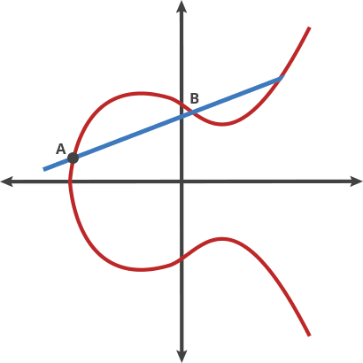
How does it work ?
We can call this billiards move on two points "dot." Any two points on a curve can be dotted together to get a new point.
A dot B = C
A dot C = D
A dot D = E
Public Key: Starting Point A, Ending Point E
Private Key: Number of hops from A to E

Slide 14

What happens if the dot function produces a line that will go way off out to some extreme ?
If the line doesn’t hit the curve close to the origin, we can define a maximum X value where the line will wrap back around and start from the beginning again.

Slide 15
History of Elliptic Curve Cryptography
The use of elliptic curves in cryptography was suggested by Neal Koblitz and Victor S. Miller in 1985. Elliptic curve cryptography algorithms entered wide use in 2004 to 2005.

Slide 16




Elliptic curves in action
After a slow start, elliptic curve-based algorithms are gaining popularity, and the pace of adoption is accelerating. ECC is now used in a wide variety of applications:
the US government uses it to protect internal communications and top-secret information
it is the mechanism used to prove ownership of bitcoins
it provides signatures in Apple's iMessage service

Slide 17
THE END
Any questions ?

Slide 18
REFERENCES
A (relatively easy to understand) primer on elliptic curve cryptography | Ars Technica
What is Elliptic Curve Cryptography? Definition & FAQs | Avi Networks
Elliptic Curve Cryptography: A Basic Introduction | Boot.dev
Elliptic Curve Cryptography Overview - YouTube

